Slide 1
Chapter No. 2
Next Generation IP
(10 Marks)

Slide 2
Why IPv6?
  Shortage of IPv4 addresses
    Internet is expanding very rapidly in developing countries like India, China
    New devices like phones need IP address
  End-to-End Reachability is not possible without IPv6
  New Features like Autoconfiguration, better support for QoS, Mobility and Security, Route Aggregation, Jumbo Frames

Slide 3
Why IPv6?
Internet Protocol Version 6(IPv6) is the latest revision of the Internet Protocol, the communication protocol that provides an identification and location system for computers on networks and routes traffic across the internet.
IPv6 was developed by IETF(Internet Engg. & task Force) to deal with the long-anticipated problem of IPv4 address exhaustion.
In contrast to IPv4, which defined an IP address as a 32-bit value, IPv6 addresses have a size of 128 bits. Therefore, IPv6 has a vastly enlarged address space compared to IPv4.

Slide 4
FEATURES OF IPV6
New Header Format
Large Address Space
Efficient and Hierarchical addressing and routing infrastructure
Stateless and stateful address configuration
Built-in Security
Better support for Quality of Service
New support for neighboring node interaction
Extensibility

Slide 5
IP addressing
--Address space
-Address space allocation
-Autoconfiguration
-Renumbering
Transition from IPV4 to IPV6
-Dual Stack
-Tunneling
-Header translation
IPV6 Protocol
-Packet Format
-Extension Header

Slide 6
IP address - Representation
IPV6 address is 128 bit long.
The 128-bit address is divided into 16-bits, and each 16-bit block is converted into 4- digit hexadecimal number and separated by colons. This type of representation is called colon hexadecimal.
The format o f IPv6 address is
xxxx: xxxx: xxxx: xxxx: xxxx: xxxx: xxxx: xxxx
where each x is a hexadecimal representing 4 bits or a nibble.
IPv6 address range from
0000:0000:0000:0000:0000:0000:0000:0000
to
FFFF: FFFF: FFFF: FFFF: FFFF: FFFF: FFFF: FFFF.

Slide 7
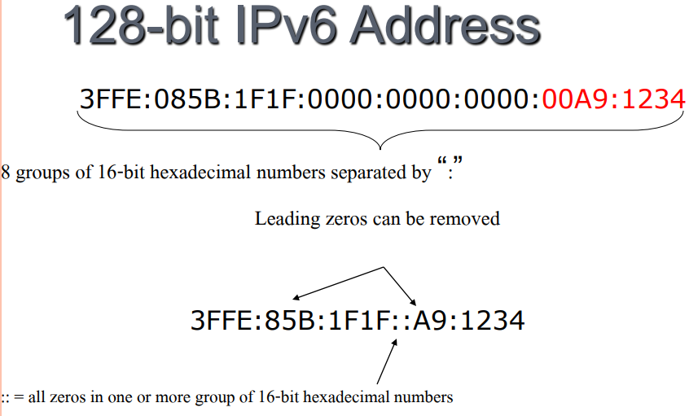
IP address - Representation

Slide 8
IPv6 Address – Examples
Ex1. show the unabbreviated colon hex notation for the following IPV6 addresses:
An address with 64 0’s followed by 64 1’s.
An address with 128 0’s
An address with 128 1’s
An address with 128 alternative 1’s & 0’s
Solution:
1. 0000:0000:0000:0000:FFFF:FFFF:FFFF:FFFF
2. 0000:0000:0000:0000:0000:0000:0000:0000
3. FFFF:FFFF:FFFF:FFFF:FFFF:FFFF:FFFF:FFFF
4. AAAA:AAAA:AAAA:AAAA:AAAA:AAAA:AAAA

Slide 9
IPv6 Address – Examples
Ex2. show abbreviations & Unabbreviated. for the following addresses:
0000:0000:FFFF:0000:0000:0000:0000:0000
1234:2345:0000:0000:0000:0000:1111
0000:0001:0000:0000:0000:0000:1200:1000
1111::2222
::
Solution:
1. 0:0:FFFF::
2. 1234:2345::1111
3. 0:1::1200:1000
4.1111:0000:0000:0000:0000:0000:0000:2222
5. 0000:0000:0000:0000:0000:0000:0000:0000

Slide 10

Show abbreviations for the following addresses:
a. 0000:0000:FFFF:0000:0000:0000:0000:0000
b. 1234:2346:0000:0000:0000:0000:0000:1111
c. 0000:0001:0000:0000:0000:0000:1200:1000
d. 0000:0000:0000:0000:0000:FFFF:24.123.12.6
Solution
a. 0:0:FFFF::
b. 1234:2346::1111
c. 0:1::1200:1000
d. ::FFFF:24.123.12.6
TCP/IP Protocol Suite

Slide 11

IPv6 Address Space
IPv4: 32 bits or 4 bytes long
    4,200,000,000 possible addressable nodes
IPv6: 128 bits or 16 bytes
    3.4 * 10³⁸ possible addressable nodes
    340,282,366,920,938,463,374,607,432,768,211,456
    5 * 10²⁸ addresses per person
    The IPv6 address is represented in hexadecimals.

Slide 12
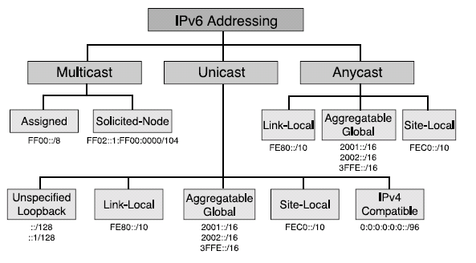
IPv6 Address Types

Slide 13

IPv6 Address Types
There are three types:-
1. Unicast
  Address is for a single interface.
  A packet sent to a unicast address is meant to be delivered to the computer specified by the address.

Slide 14
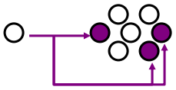
IPv6 Address Types
2. Multicast
  One-to- Many.
  Enables more efficient use of the network.
  Uses a larger address range
  Multicast is the delivery of a message or information to a group of destination computers simultaneously in a single transmission from the source.
  Multicast addresses: FF0X::<Group ID>
Note That:- There are no broadcast addresses in IPv6 (multicast replaces broadcast).

Slide 15

IPv6 Address Types
3. Anycast
  Anycast addresses are new in IPv6.
  One-to-nearest (allocated from unicast address space) Anycast packets are routed to the nearest host. .
  Multiple devices share the same address.
  All anycast nodes should provide uniform service.
  Source devices send packets to anycast address.

Slide 16
IPV6 Address Types
IPv6
There are three types of IPv6 address :
Unicast :- Unicast transmission is the sending of messages to a single network destination identified by a unique address.
Anycast :- Anycast is a network addressing and routing methodology in which datagrams from a single sender are routed to the topologically nearest node in a group of potential receiver, though it may be sent to a several nodes, all identified by the same destination address.

Slide 17
Address Space Allocation
Like the address space of IPv4, The IPV6 address is divided into several categories & the category of address can be determined from the few leftmost bits of address.
These leftmost bits that determines the category of address is called type prefix.
Most of the blocks are still unassigned and have been left aside for future use.
To better understand the allocation and the location of each block in address space, we first divide the whole address space into eight equal ranges.
This division does not show the block allocation, but we believe it shows where each actual block is located.

Slide 18
Address Space Allocation
General structure of IPv6 address
Network prefix:- Where are you connected to.
Interface ID:- Who are you. Created from MAC address or from IPv4 address (IPv6 compatible addresses).

Slide 19
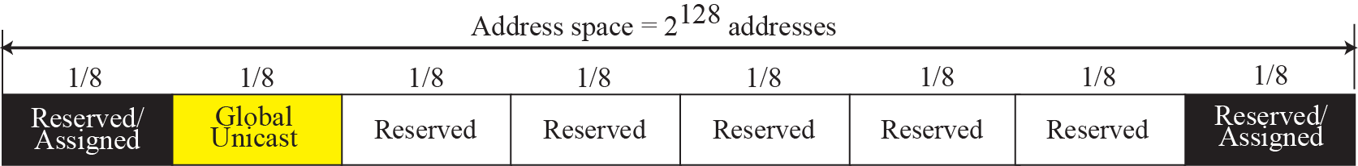
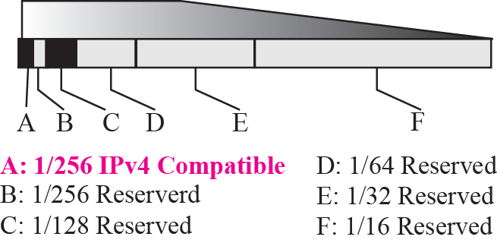
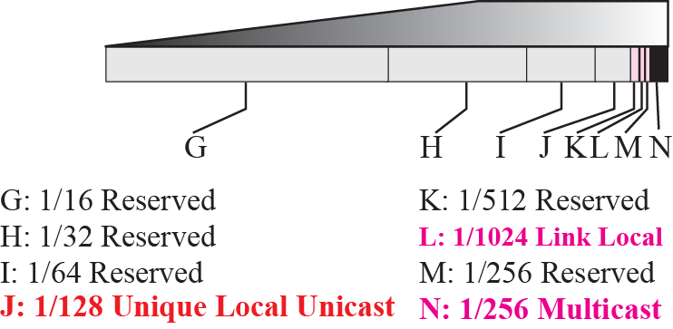
Address Space Allocation
Each section in one-eighth of the whole address space(2125 addresses).
First section contains six variable size blocks; 3 of these blocks are reserved & three unassigned.
Second section is considered one single block & is used for global unicast.
The next five sections are unassigned.
Last section is divided into eight blocks. Some of these blocks are still unassigned & some are reserved for special purposes.

Slide 20
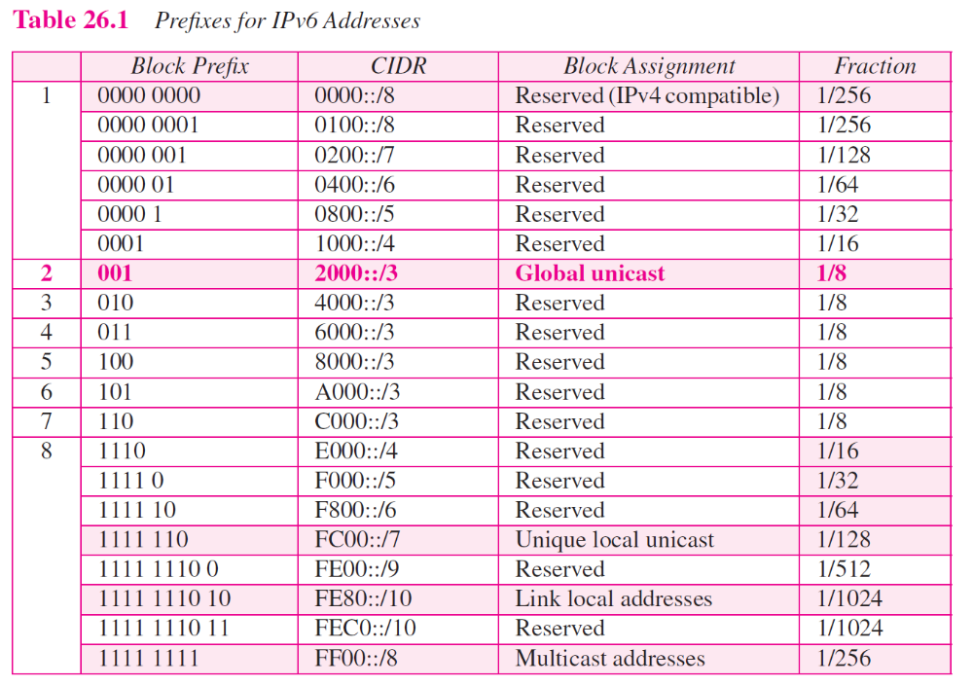
Address Space Allocation

Slide 21
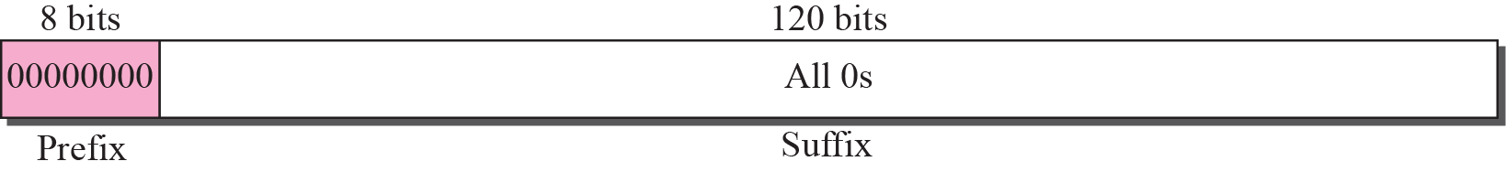
Types of Addresses
Unspecified address
The unspecified address in IPv6 is ::/128.
It should never be used as a destination address.

Slide 22
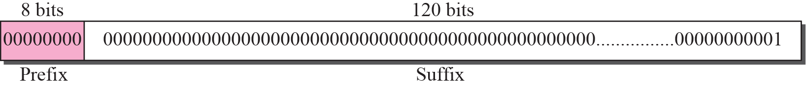
Types of Addresses
Loopback address
The loopback address in IPv6 is ::1/128.
This subblock also consists of one single address. This is an address used by a host to test itself without going into the network.
It should never be used as a destination address.

Slide 23
Example
Compare the loop addresses in IPv4 to the loopback address in IPv6.
Solution:-
There are two differences in this case.
In classful addressing, a whole block is allocated for loopback addresses; in IPv6 only one address is allocated as the loopback address.
In addition, the loopback block in classful addressing is part of the class A block. In IPv6, it is only one single address in the reserved block.

Slide 24
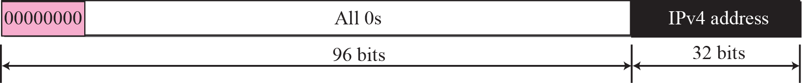
Types of Addresses- Embedded IPV4 Address
1. Compatible address
A compatible address is an address of 96 bits of zero followed by 32 bits of IPV4 address.
The situation in which the compatible address is required to be used is as follows: if an IPV6 host wants to communicate with another IPV6 host but the packet is going to pass through a region in which still the IPV4 is being used by the networks.

Slide 25
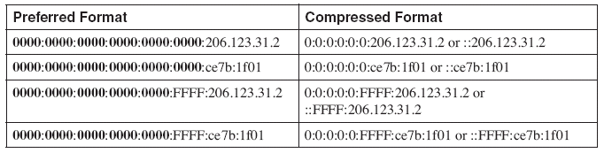

Slide 26
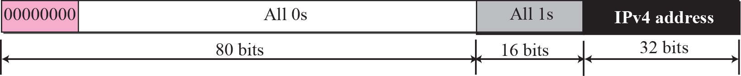
Types of Addresses
2. Mapped address
A mapped address comprises 80 bits of zero, followed by 16 bits of one, followed by the 32 bit IPV4 address.
It is used when computer that has migrated to IPV6 wants to send a packet to a computer still using IPV4.
The packet travels mostly through IPV6 networks but is finally delivered to host that uses IPV4.

Slide 27
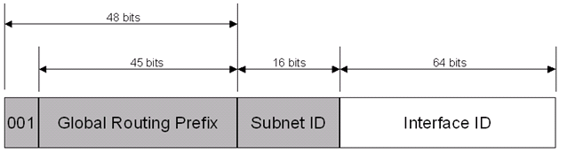
Types of Addresses
3. Global Unicast Addresses
Equivalent to public IPv4 addresses.
Globally routable and reachable on the IPv6 portion of the Internet.
The scope, the portion of the IPv6 internetwork over which the address is unique, of a global unicast address is the entire IPv6 Internet.
Global scoped communication are identified by high-level 3 bits set to 001 (2000::/3)

Slide 28
Types of Addresses
4. Local-Use Unicast Addresses
There are two types of local-use unicast addresses:
  Link-local addresses
    used between on-link neighbours and for Neighbour Discovery Processes.
  Site-local addresses
    used between nodes communicating with other nodes in the same site.

Slide 29
4. Local-Use Unicast Addresses
  1. Link-local unicast addresses: (APIPA)
  IPv6 link-local addresses are equivalent to IPv4 link-local addresses defined in RFC 3927 that use the 169.254.0.0/16 prefix.
  IPv4 link-local addresses are known as Automatic Private IP Addressing (APIPA) addresses for computers running current Microsoft Windows operating systems.
  The scope of a link-local address is the local link.
  A link-local address is required for Neighbour Discovery (NDP) processes and is always automatically configured, even in the absence of all other unicast addresses.

Slide 30
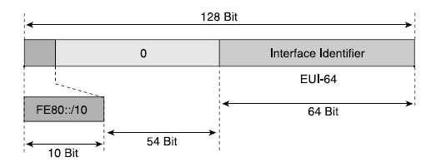
4. Local-Use Unicast Addresses
Used only between nodes connected on the same local link.
IPv6 link-local prefix FE80::/10 is used and the interface identifier in Extended Unique Identifier 64 (EUI-64) format is appended as the address’s low-order 64-bit.
Link-local addresses are only for local-link scope and must never be routed between subnets within a site.

Slide 31
4. Local-Use Unicast Addresses
  2. Site-Local Address (Private IP address in IPV4 )
  Site-local addresses are equivalent to the IPv4 private address space (10.0.0.0/8, 172.16.0.0/12, and 192.168.0.0/16).
  Site-local addresses are not reachable from other sites, and routers must not forward site-local traffic outside the site.
  Site-local addresses can be used in addition to global unicast addresses.
  The scope of a site-local address is the site.
  A site is an organization network or portion of an organization's network that has a defined geographical location (such as an office, an office complex, or a campus).

Slide 32
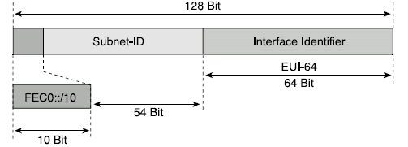
4. Local-Use Unicast Addresses
  2. Site-Local Address (Private IP address in IPV4 )
Unlike link-local addresses, site-local addresses are not automatically configured and must be assigned either through stateless or stateful address configuration processes.
May be assigned to any nodes and routers within a site.

Slide 33
Site-Local Address - Example
For example, a site with ten subnets may assign site-local prefixes such as the following:
  Subnet 1—FEC0:0:0:0001::/64
  Subnet 2—FEC0:0:0:0002::/64
  Subnet 3—FEC0:0:0:0003::/64
  Subnet 4—FEC0:0:0:0004::/64
  Subnet 5—FEC0:0:0:0005::/64
  Subnet 6—FEC0:0:0:0006::/64
  Subnet 7—FEC0:0:0:0007::/64
  Subnet 8—FEC0:0:0:0008::/64
  Subnet 9—FEC0:0:0:0009::/64
  Subnet 10—FEC0:0:0:000A::/64
IPv6 Addressing

Slide 34
Types of Addresses
5. Multicast Address:-
In IPv6, multicast traffic operates in the same way that it does in IPv4.
IPv6 nodes can listen to multiple multicast addresses at the same time.
IPv6 multicast addresses have the first eight bits set to 1111 1111.
An IPv6 address is easy to classify as multicast because it always begins with “FF”.
Multicast addresses cannot be used as source addresses or as intermediate destinations in a Routing extension header.
Beyond the first eight bits, multicast addresses include additional structure to identify their flags, scope, and multicast group.

Slide 35
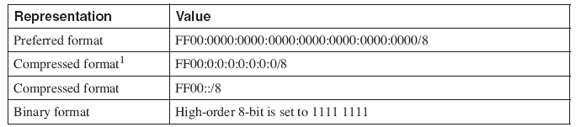
Types of Addresses
5. Multicast Address:-
Main goal of multicasting is having an efficient network to save bandwidth on links by optimizing the number of packets exchanged between nodes
In IPv4:
  224.0.0.0/3, where the high-order 3-bit of the IPv4 address is set to 111

Slide 36
Multicast Address
IPv6 makes heavy use of multicast addresses in the mechanisms of the protocol such as
  The replacement of Address Resolution Protocol (ARP) in IPv4
  Prefix advertisement
  Duplicate Address Detection (DAD)
  Prefix renumbering.
Format of the multicast address defines several scopes and types of addresses using the 4-bit fields Flag and Scope.
These fields are located after the FF::/8 prefix.
The low-order 112-bit of the multicast address is the multicast group ID.
IPv6 Addressing

Slide 37
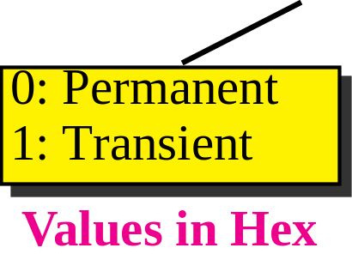
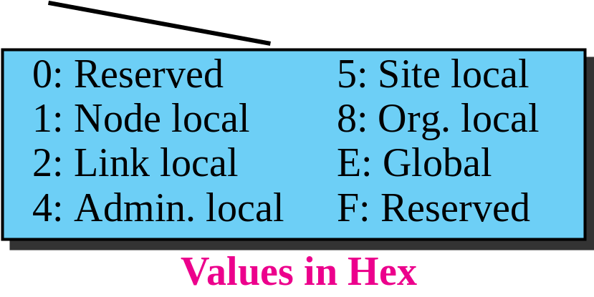
Format of the Multicast Address fields
  The first low-order bit = Transient (T) flag.
    T = 0 → T flag indicates that the multicast address is a permanently assigned (well-known) multicast address allocated by IANA.
    T = 1 → T flag indicates that the multicast address is a transient (non-permanently-assigned) multicast address.

Slide 38
Format of the Multicast Address:
Scope Field
Indicates the scope of the IPv6 internetwork for which the multicast traffic is intended.
The size = 4 bits.
In addition to information provided by multicast routing protocols, routers use the multicast scope to determine whether multicast traffic can be forwarded.
The most prevalent values for the Scope field are:
  1 (interface-local scope)
  2 (link-local scope)
  5 (site-local scope)
For example:
  Traffic with the multicast address of FF02::2 has a link-local scope.
  An IPv6 router never forwards this traffic beyond the local link.
IPv6 Addressing

Slide 39
Autoconfiguration
One important goal for IPv6 is to support node Plug and Play. i. e, it should be possible to plug a node into an IPv6 network and have it automatically configured without any human intervention.
One of the interesting features of IPv6 addressing is the Autoconfiguration of hosts.
As we discussed in IPv4, the host and routers are originally configured manually by the network manager.
However, the Dynamic Host Configuration Protocol, DHCP, can be used to allocate an IPv4 address to a host that joins the network.
In IPv6, DHCP protocol can still be used to allocate an IPv6 address to a host, but a host can also configure itself.

Slide 40
Types of Autoconfiguration
IPv6 supports the following types of auto-configuration:
Stateful auto-configuration.
This type of configuration requires a certain level of human intervention because it needs a Dynamic Host Configuration Protocol for IPv6 (DHCPv6) server for the installation and administration of the nodes.
The DHCPv6 server keeps a list of nodes to which it supplies configuration information. It also maintains state information so the server knows how long each address is in use, and when it might be available for reassignment.

Slide 41
Types of Autoconfiguration
IPv6 supports the following types of auto-configuration:
2. Stateless auto-configuration.
This method is called “stateless” because it begins from a “dead start” with no information (or “state”) at all for the host to work with, and has no need for a DHCP server.
This type of configuration is suitable for small organizations and individuals.
In this case, each host determines its addresses from the contents of received router advertisements.

Slide 42
Types of Autoconfiguration
The following is a summary of the steps a device takes when using stateless Autoconfiguration:
Link-Local Address Generation
Link-Local Address Uniqueness Test: The node tests to ensure that the address it generated isn't for some reason already in use on the local network.
Link-Local Address Assignment:-Assuming the uniqueness test passes, the device assigns the link-local address to its IP interface.
Router Contact: The node next attempts to contact a local router for more information on continuing the configuration.
Router Direction: The router provides direction to the node on how to proceed with the Autoconfiguration
Global Address Configuration: Assuming that stateless Autoconfiguration is in use on the network, the host will configure. itself with its globally-unique Internet address.

Slide 43
IPv6 Protocol
Internet Protocol version 6 (IPv6) is the most recent version of the Internet Protocol (IP), the communications protocol that provides an identification and location system for computers on networks and routes traffic across the Internet.
IPv6 was developed by the Internet Engineering Task Force (IETF) to deal with the long-anticipated problem of IPv4 address exhaustion.
IPv6 is intended to replace IPv4. In December 1998.

Slide 44
IPv6 Header Format
IPv4: 20 Bytes + Options
IPv6: 40 Bytes + Extension Header
IPv6 Header
IPv4 Header
Version
Traffic
Class
Flow Label
Version
IHL
Type of
Service
Total Length
Identification
Flags
Fragment
Offset
Payload Length
Next
Header
Hop Limit
Time to Live
Protocol
Header Checksum
Source Address
Source Address
Destination Address
Options
Padding
Destination Address

Slide 45
IPv6 Header Format
Version (4 bits):- It is set to constant 6 (bit sequence 0110).
Traffic Class (6+2 bits) :
  The bits of this field hold two values. The six most-significant bits hold the Differentiated Services (DS) field, which is used to classify packets Currently, all standard DS fields end with a '0' bit. Any DS field that ends with two '1' bits is intended for local or experimental use.
  The remaining two bits are used for Explicit Congestion Notification (ECN), priority values subdivide into ranges: traffic where the source provides congestion control and non-congestion control traffic.
Flow Label (20 bits):- Originally created for giving real-time applications special service.
When set to a non-zero value, it serves as a hint to routers and switches with multiple outbound paths
  that these packets should stay on the same path, so that they will not be reordered.[6][7] It has further been suggested that the flow label be used to help detect spoofed packets

Slide 46
Stateless Autoconfiguration
IPv6
  Stateless Address Configuration (IP Address, Default Router Address)
  Routers sends periodic Router Advertisement
  Node gets prefix information from the Router advertisement and generates the complete address using its MAC address
  Global Address=Link Prefix + EUI 64 Address
  Router Address is the Default Gateway

Slide 47
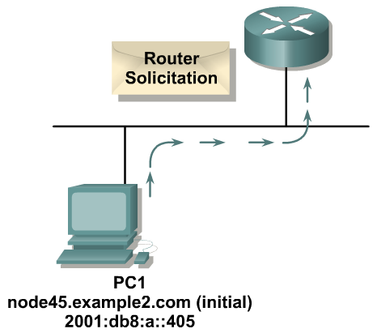
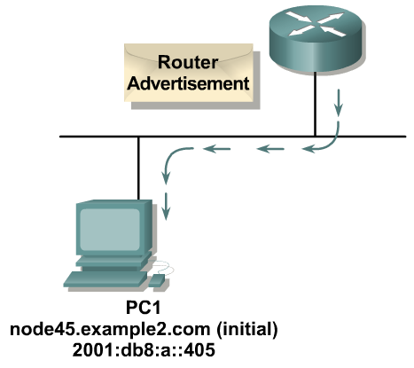
Stateless Autoconfiguration Example
IPv6
  MAC address: 00:0E:0C:31:C8:1F
  EUI 64 Address: 20E:0CFF:FE31:C81F
  Router Solicitation is sent on FF01::2 (All Router Multicast Address) and Advertisement sent on FF01::1 (All Node Multicast Address)

Slide 48
IPv6 Address Example
IPv6
  [root@vsnlproxy ~]# ifconfig
  eth0 Link encap:Ethernet HWaddr 00:18:71:E5:47:82
  inet addr:172.31.1.227 Bcast:172.31.255.255 Mask:255.255.0.0
  inet6 addr: 2001:df0:92:0:218:71ff:fee5:4782/64 Scope:Global
  inet6 addr: fe80::218:71ff:fee5:4782/64 Scope:Link

Slide 49
DHCPv6
IPv6
  Stateful Configuration
  Provides not only IP address, also other configuration parameters like DNS
8
0
7
0
0
4
2
9
0
11
0
4
14
0
7
6
8
4
0
0
0
10
1
2

Slide 50
DHCPv6
IPv6
  Client
    Initiates requests on a link to obtain configuration parameters
    use its link local address to connect the server
    Send requests to FF02::1:2 multicast address
  (All_DHCP_Relay_Agents_and_Servers)
  Relay Agent/ DHCPv6 Server
    node that acts as an intermediary to deliver DHCP messages
    between clients and servers
    is on the same link as the client
    Is listening on multicast addresses:
  All_DHCP_Relay_Agents_and_Servers (FF02::1:2)

Slide 51
Routing in IPv6
IPv6
  Same Protocols as in IPv4
    Static
    RIPng
    OSPFv3
    MP-BGP4
  Use ping6 and traceroute6 commands to check reachability and route

Slide 52
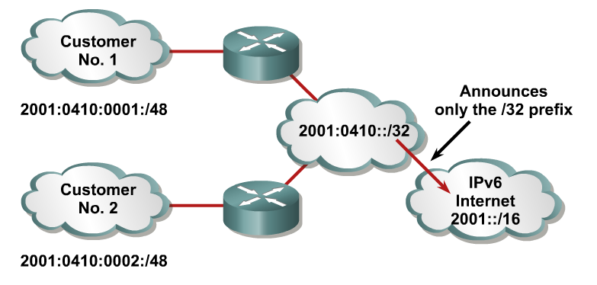
Routing in IPv6
IPv6
Aggregation of prefixes announced in the global
routing table
Efficient and scalable routing

Slide 53
Neighbor Discovery
IPv6
IPv6 nodes which share the same physical medium (link) use Neighbor Discovery (NDP) to:
  Discover their mutual presence
  Determine link-layer addresses of their neighbors
  (equivalent to ARP)
  Find routers
  Maintain neighbors’ reachability information
Uses Multicast Address

Slide 54
Neighbor Discovery
IPv6
Protocol features:
Router discovery
Prefix(es) discovery
Parameters discovery (link MTU, Max Hop Limit, ...)
Address auto-configuration
Address resolution
Next Hop determination
Neighbor Unreachability Detection
Duplicate Address Detection
Redirect

Slide 55
Neighbor Discovery
IPv6
It provides the functionality of:
ARP
ICMP redirect

Slide 56
Neighbor Discovery
IPv6
ND specifies 5 types of ICMP packets:
Router Advertisement (RA) :
Periodic advertisement (of the availability of a router) which contains:
»list of prefixes used on the link (autoconf)
»a possible value for Max Hop Limit (TTL of IPv4)
»value of MTU
Router Solicitation (RS) :
The host needs RA immediately (at boot time)

Slide 57
Neighbor Discovery
IPv6
Neighbor Solicitation (NS):
»to determine the link-layer address of a neighbor
»or to check its reachability
»also used to detect duplicate addresses (DAD)
Neighbor Advertisement (NA):
»answer to a NS packet
»to advertise the change of physical address
Redirect:
»Used by a router to inform a host of a better route to a given destination

Slide 58

Transition to IPv6
Navpreet Singh
Computer Centre
Indian Institute of Technology Kanpur
Kanpur INDIA
(Ph.. : 2597371, Email : navi@iitk.ac.in)

Slide 59
Transition Mechanism
IPv6
  No fixed day to convert; no need to convert all at once.
  Transition Options:
    Dual Stack
    IPv6-IPv4 Tunnel
    IPv6-IPv4 Translation

Slide 60
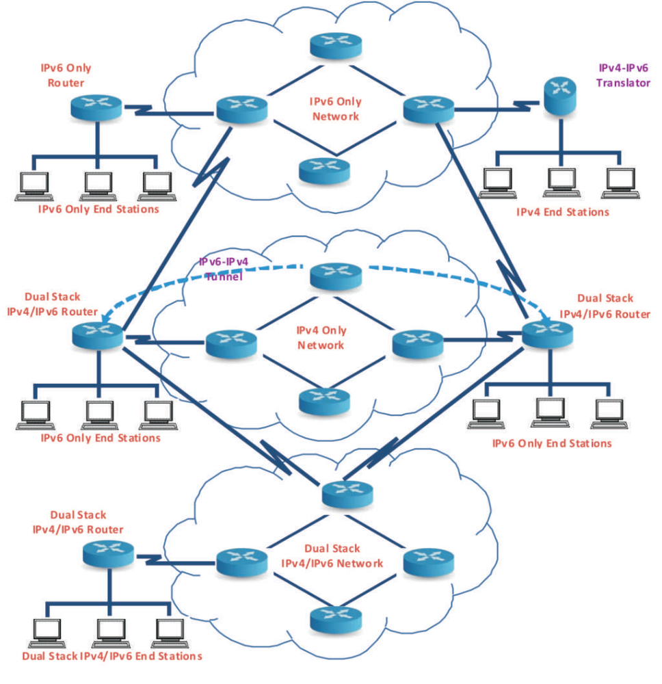
Transition Mechanism
IPv6

Slide 61
6/4 Dual Stack Hosts and Network
IPv6
This allows all the end hosts and intermediate network devices (like routers, switches, modems etc.) to have both IPv4 and IPv6 addresses and protocol stack.
If both the end stations support IPv6, they can communicate using IPv6; otherwise they will communicate using IPv4.
This will allow both IPv4 and IPv6 to coexist and slow transition from IPv4 to IPv6 can happen.

Slide 62

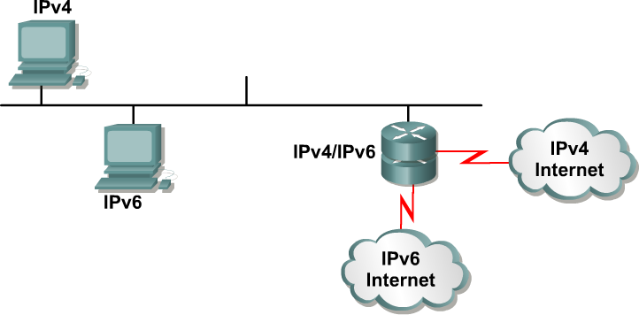

6/4 Dual Stack Hosts and Network
IPv6

Slide 63
6/4 Dual Stack Hosts and Network
IPv6
IITK_KNPR_CMTR_DIA#sh run
Building configuration...
interface GigabitEthernet0/1
description Connected to IITK
ip address 203.197.196.18 255.
ipv6 address 2001:DF0:92::1/64
ipv6 enable
!
interface GigabitEthernet0/2
description Airtel IPv6 Connectivity
ip address 59.144.72.85 255.255.255.2
ipv6 address 2404:A800:2:D::2/64
ipv6 enable
!

Slide 64
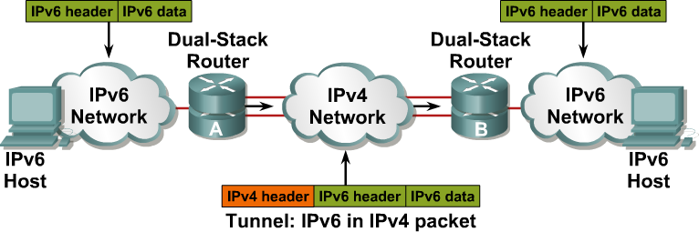
Tunneling IP6 via IP4
IPv6
This allows encapsulating IPv6 packets in IPv4 packets for transport over IPv4 only network.
This will allow IPv6 only end stations to communicate over IPv4 only networks.

Slide 65
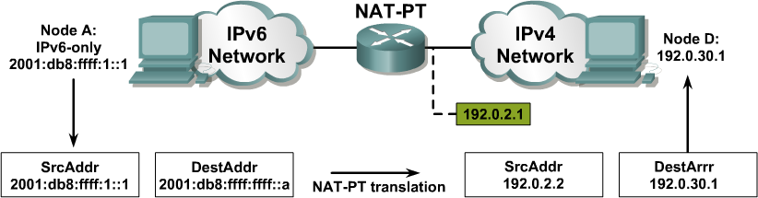
IP6-IP4 Translation
IPv6
This allows communication between IPv4 only and IPv6 only end stations.
The job of the translator is to translate IPv6 packets
into IPv4 packets by doing address and port
translation and vice versa.

Slide 66
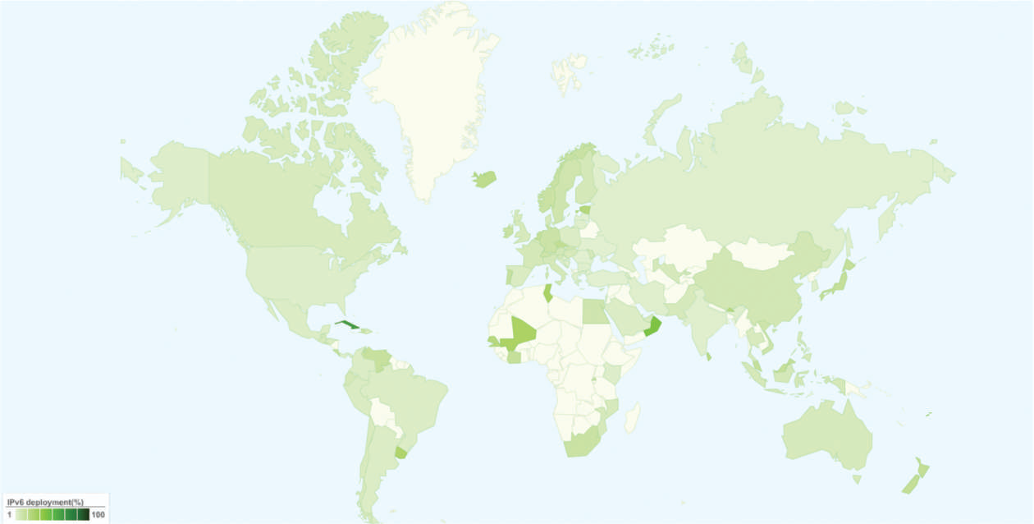
Current Status of IPv6 Deployment
IPv6

Slide 67
What, When and How to Migrate
IPv6
All the major Operating Systems support IPv6.
Most of the new network equipment supports IPv6 either by default or is available as an upgrade.
Countries like US, France, Canada, Japan, China, and South Korea etc. have taken a lead in IPv6 deployment. The government in these countries have strongly promoted the use of IPv6 and also mandated the support of IPv6 by all equipment manufacturers and suppliers and service providers.
China has launched China Next Generation Internet (CNGI) which is based on IPv6. China also showcased IPv6 readiness in the Beijing 2008 Olympics.
IT IS TIME FOR INDIA TO ACT

Slide 68
Migration Steps
IPv6
Check IPv6 compliance:
  Study the existing network and verify that all the equipment installed supports IPv6.
  Recommend upgrade of the equipment which does not support software upgrade or hardware upgrade/replacement.
  All future equipment purchase must ensure that the equipment is IPv6 compatible.

Slide 69
Migration Steps
IPv6
2. Plan IPv6 addressing:
Take IPv6 addresses from the Regional Internet Registry (APNIC in case of India) or upstream Internet provider.
Make IPv6 Address allocation policy and plan IPv6 addressing for the entire network.

Slide 70
Migration Steps
IPv6
Enable IPv6 Routing:
Enable IPv6 routing in the entire network.
For organization LANs, this would require IPv6 address configuration in all Layer 3 switches and routers and enable static/ dynamic routing.
In case of Service provider networks, this would require configuring Provider Edge (PE) Routers as 6PE to support IPv6 over MPLS (Multi Protocol Label Switching) backbone, enabling IPv6 routing in the Customer Edge (CE) Router or Customer Premise Equipment (CPE) to connect the customer network over IPv6 and enabling BGP (Border Gateway Protocol) routing over IPv6 with the upstream providers to provide Internet access over IPv6.
The IPv6 routes to customer networks may be static or BGP

Slide 71
Migration Steps
IPv6
4. Setup IPv6 Application Servers:
Upgrade the Domain Name servers to support IPv6 address resolution.
Other servers like Web servers, Mail servers, Network Management servers, Authentication/ AAA servers etc. can also be upgraded to support IPv6.

Slide 72
Migration Steps
IPv6
5. Enable IPv6 Peering:
Enable IPv6 peering with upstream Internet providers.
Service Providers need to enable IPv6 peering with other ISPs (Internet Service Providers) also through Internet Exchange (NIXI in case of India).

Slide 73
Migration Steps
IPv6
6. Migrate Services on IPv6:
Test various services like Internet access, Email, VoIP, IPTv etc. on IPv6 and migrate the services to support both IPv6 and IPv4.
Service Providers should test and migrate their services like Internet Leased Line, VPN, Broadband, Multiplay, and Mobile etc. to support both IPv6 and IPv4.

Slide 74
IPv6 QoS
Navpreet Singh
Computer Centre
Indian Institute of Technology Kanpur
Kanpur INDIA
(Ph : 2597371, Email : navi@iitk.ac.in)

Slide 75
About Myself
About Myself
I am Principal Computer Engineer at IIT Kanpur and I manage the Campus Network and Internet Services of IITK.
IIT Kanpur has one of the largest networks in the country.
  IITK Campus Network now has more than 15000 nodes providing connectivity to more than 8000 users in Academic Departments, Student Hostels and Residences.
  IITK has three 1 Gbps Internet Connectivity.
  All application servers (Mail, DNS, Proxy Caching, Web etc.) are maintained in-house.
B.Tech (1990) and M.Tech (1996) from IIT Kanpur
Working in IIT Kanpur for more than 17 years

Slide 76
IPv6 Security
Navpreet Singh
Computer Centre
Indian Institute of Technology Kanpur
Kanpur INDIA
(Ph : 2597371, Email : navi@iitk.ac.in)

Slide 77
About Myself
About Myself
I am Principal Computer Engineer at IIT Kanpur and I manage the Campus Network and Internet Services of IITK.
IIT Kanpur has one of the largest networks in the country.
  IITK Campus Network now has more than 15000 nodes providing connectivity to more than 8000 users in Academic Departments, Student Hostels and Residences.
  IITK has 1 Gbps Internet Connectivity.
  All application servers (Mail, DNS, Proxy Caching, Web etc.) are maintained in-house.
B.Tech (1990) and M.Tech (1996) from IIT Kanpur
Working in IIT Kanpur for more than 17 years

Slide 78
IPv6 Security
IPv6
IPv4 was not designed with security in mind.
Packet Sniffing: Due to network topology, IP packets sent from a source to a specific destination can also be read by other nodes, which can then get hold of the payload (for example, passwords or other private information).
IP Spoofing: IP addresses can be very easily spoofed both to attack those services whose authentication is based on the sender’s address (as the rlogin service or several WWW servers).
Connection Hijacking: Whole IP packets can be forged to appear as legal packets coming from one of the two communicating partners, to insert wrong data in an existing channel.

Slide 79
IPv6 Security
IPv6
In IPv4, Security is implemented in:
Applications – HTTPS, IMAPS, SSH etc.
IPsec tunnels

Slide 80
Security in IPv6
IPv6
IPv4 - NAT breaks end-to-end network security
IPv6 - Huge address range – No need of NAT

Slide 81
Security in IPv6
IPv6
Reconnaissance In IPv6:
Default subnets in IPv6 have 2⁶⁴ addresses
Scan with 10 Mpps will take more than 50 000 years
Ping sweeps on IPv6 networks are not possible

Slide 82
Security in IPv6
IPv6
Viruses and Worms In IPv6:
Viruses and Email, IM worms: IPv6 brings no change.
Other worms:
  IPv4: reliance on network scanning
  IPv6: not so easy
  Worm developers will adapt to IPv6
IPv4 best practices around worm detection and mitigation remain valid.
IPS systems and Anti-viruses will not change.

Slide 83
IPv6 IPsec
IPv6
Applies to both IPv4 and IPv6:
– Mandatory for IPv6
– Optional for IPv4
Applicable to use over LANs, across public &
private WANs, & for the Internet
IPSec is a security framework
– Provides suit of security protocols
– Secures a pair of communicating entities
–Two different modes: Transport mode (host-to-
host) and Tunnel Mode (Gateway-to-Gateway or
Gateway-to-host)

Slide 84
IPv6 IPsec Protocol
IPv6
Services Provided by IPsec
Authentication – ensure the identity of an entity (integrity) and replay protection
Confidentiality – protection of data from unauthorized disclosure
Key Management – generation, exchange, storage, safeguarding, etc. of keys in a public key cryptosystem

Slide 85
IPv6 IPsec Protocol
IPv6
IPsec Services
Authentication: AH (Authentication Header - RFC 4302)
Confidentiality: ESP (Encapsulating Security Payload - RFC 4303)
Key management: IKEv2 (Internet Key Exchange - RFC4306)
When two computers (peers) want to communicate using IPSec, they mutually authenticate with each other first and then negotiate how to encrypt and digitally sign traffic they exchange. These IPSec communication sessions are called security associations (SAs).

Slide 86
IPv6 IPsec Protocol
IPv6
IPsec Services
S-HTTP
S/MIME
HTTP
FTP
SMTP
TCP
TCP
IP
AH
ESP
Application approach
IP
Network approach

Slide 87
IPv6 IPsec Protocol
IPv6
IPsec AH
IPv6 AH Packet Format
IPv6 Header
Hop-by-Hop
Routing
Authentication
Header
Other Headers
Higher Level
Protocol Data
IPv6 AH Header Format
Next Header
Length
Reserved
Security Parameters Index
Authentication Data (variable number of 32-bit words)

Slide 88
IPv6 IPsec Protocol
IPv6
IPsec ESP
ESP Format
Security Parameters Index (SPI)
Initialization Vector (optional)
Replay Prevention Field (incrementing count)
Payload Data (with padding)
Authentication checksum

Slide 89
IPv6 IPsec Protocol
IPv6
Implementations
Linux-kernel 2.6.x onwards
Cisco IOS-12.4(4)T onwards
Windows Vista onwards

Slide 90
Security Issues in IPv6
IPv6
IPsec Key Exchange Protocol not yet fully Standardized
Scanning possible – If IP address assignment is poorly designed
No protection against all denial of service attack
(DoS attacks difficult to prevent in most cases)
No many firewalls in market with V6 capability

